Slide 2
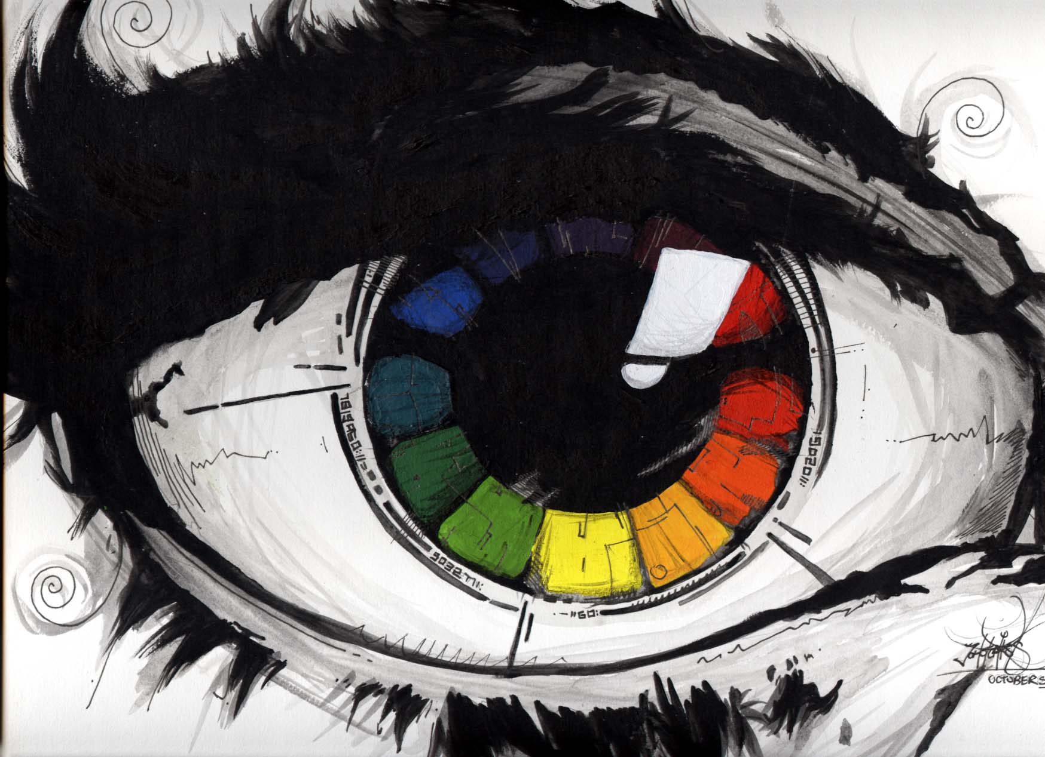
How
do
we
see
colour ?

Slide 3
The sunlight ( having all colours) falls on objects,
and the object absorbs most of the colours
and returns some colours.
WE SEE ONLY THE COLOUR WHICH
IS RETURND BY THE OBJECT
If we see a red rose, the red color is reflected
and all other colors are absorbed
Leaves are green, it means all colours
are absorbed and green is reflected

Slide 4
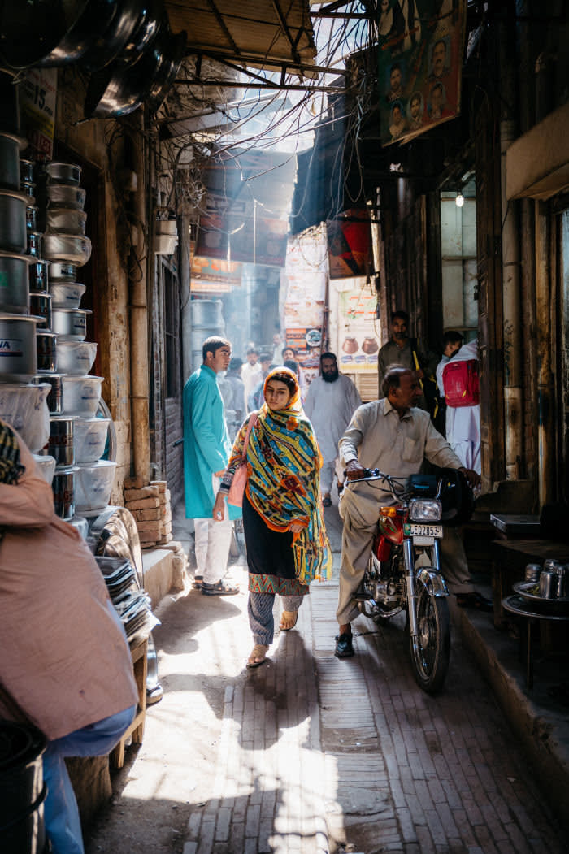

Slide 5
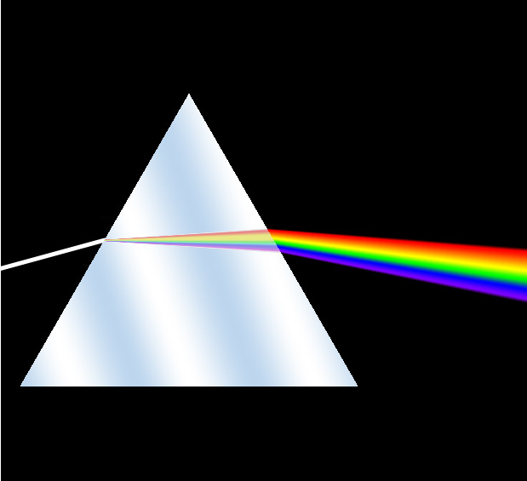
All colours are present in a single ray of light

Slide 6
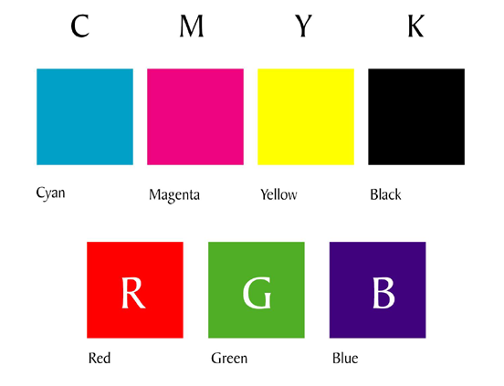
Basic
Pigment
Colours
Basic
Light
Colours

Slide 7

R
B
G

Slide 8
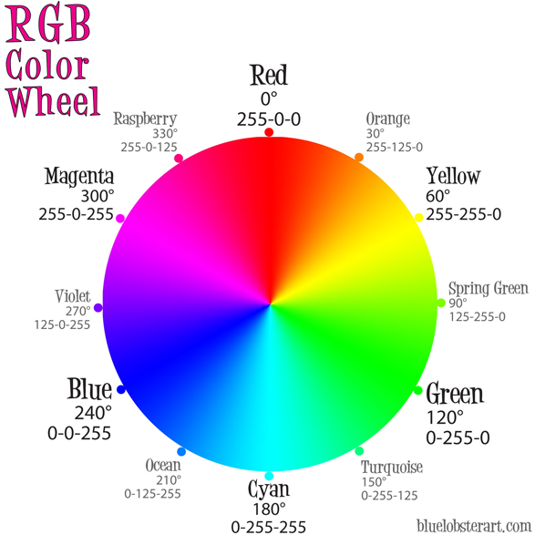

Slide 9
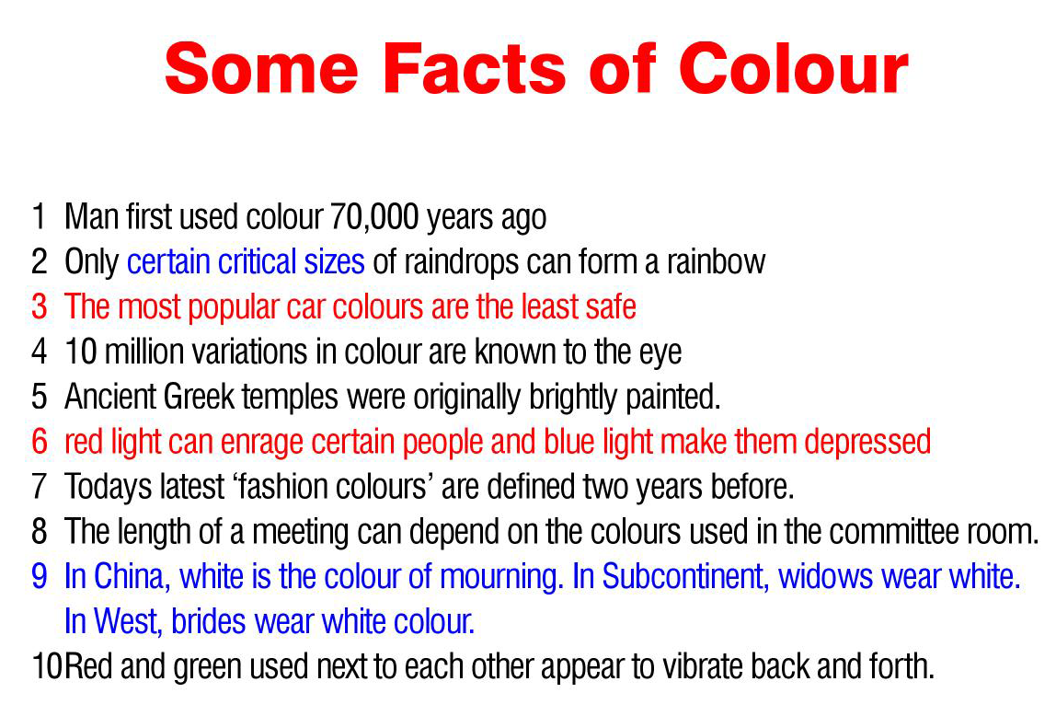

Slide 10
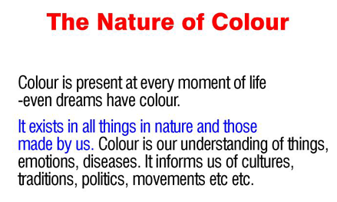

Slide 11
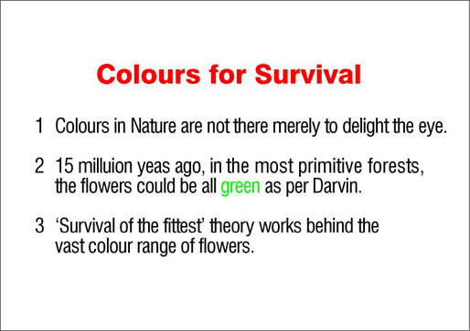
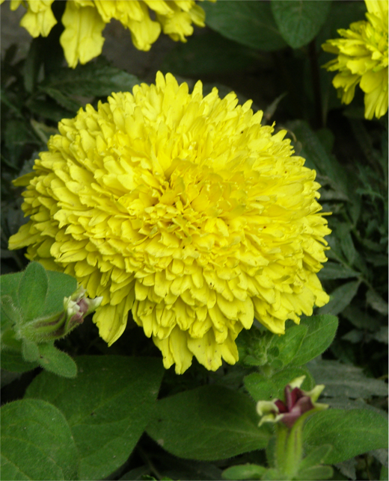
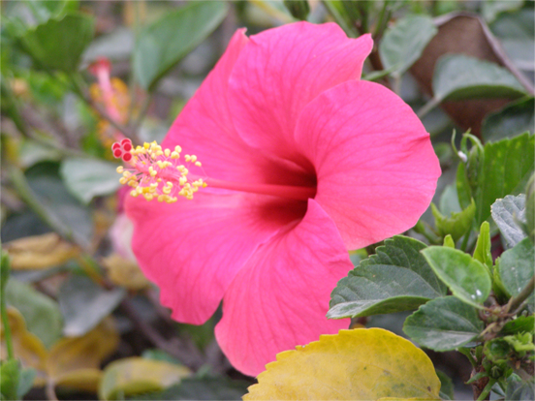

Slide 12
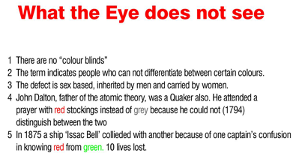

Slide 13
